Slide 1
MATLAB for image processing Session 3: Advanced data structures

Slide 2
Course structure
Session 1
Introduction to MATLAB
Data types
Conditional statements and loops
Session 3
Advanced data structures
Object-oriented programming
Advanced image reading (Bio-Formats)
Session 2
Arrays and matrices
Image processing
Session 4
Figures and plotting
Designing a user interface

Slide 3

Under construction!
Comments/requests?
Let me know!
stephen.cross@bristol.ac.uk

Slide 4
Advanced data structures
Notes:
Convert this into 2 spider diagrams if there’s time

Slide 5
Advanced data structures
Arrays and matrices recap
Arrays are a regular grid of numbers in N dimensions
Vectors are 1D arrays, matrices are 2D arrays
☺ Fast access to subsets via indexing
☺ Fast calculations on all values
☹ Can only store numeric values
Alternatives for mixed data types
Cell arrays
Tables
Structure arrays (aka “structs”)

Slide 6
Structure arrays
Notes:
Convert this into 2 spider diagrams if there’s time

Slide 7
Structure arrays
Values stored as “fields”
Accessed using that field’s reference via dot notation
Can hold different data types in each field
Can have fields within fields
Example struct creation
im_meas.filename = ‘cell_image_001.tif’
im_meas.xy_calib = 0.0127
im_meas.centroids.obj_1 = [103, 24]
im_meas.centroids.obj_2 = [87, 216]
im_meas.centroids.obj_3 = [4, 68]

Slide 8
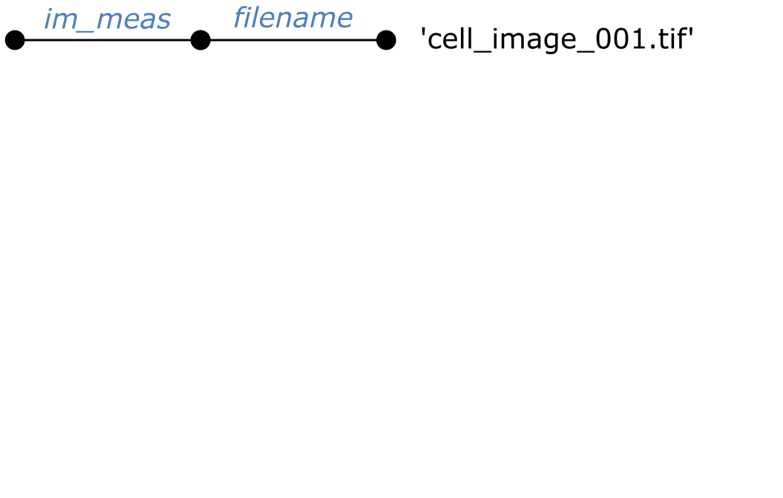
Structure arrays
Values stored as “fields”
Accessed using that field’s reference via dot notation
Can hold different data types in each field
Can have fields within fields
Example struct creation
im_meas.filename = ‘cell_image_001.tif’
im_meas.xy_calib = 0.0127
im_meas.centroids.obj_1 = [103, 24]
im_meas.centroids.obj_2 = [87, 216]
im_meas.centroids.obj_3 = [4, 68]

Slide 9
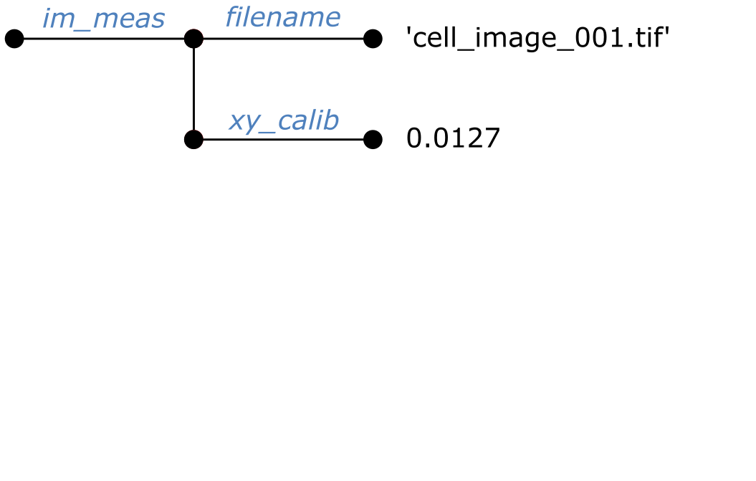
Structure arrays
Values stored as “fields”
Accessed using that field’s reference via dot notation
Can hold different data types in each field
Can have fields within fields
Example struct creation
im_meas.filename = ‘cell_image_001.tif’
im_meas.xy_calib = 0.0127
im_meas.centroids.obj_1 = [103, 24]
im_meas.centroids.obj_2 = [87, 216]
im_meas.centroids.obj_3 = [4, 68]

Slide 10
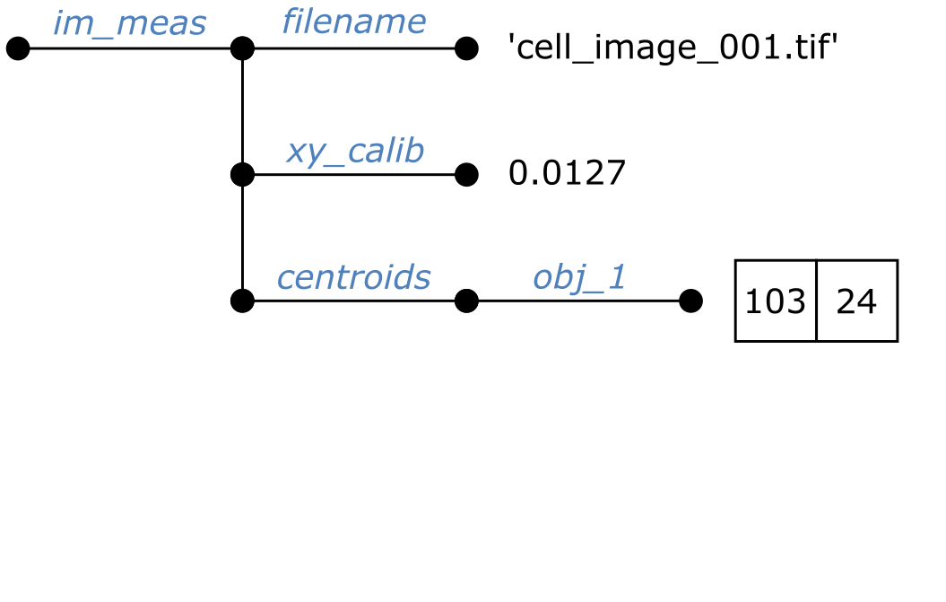
Structure arrays
Values stored as “fields”
Accessed using that field’s reference via dot notation
Can hold different data types in each field
Can have fields within fields
Example struct creation
im_meas.filename = ‘cell_image_001.tif’
im_meas.xy_calib = 0.0127
im_meas.centroids.obj_1 = [103, 24]
im_meas.centroids.obj_2 = [87, 216]
im_meas.centroids.obj_3 = [4, 68]

Slide 11
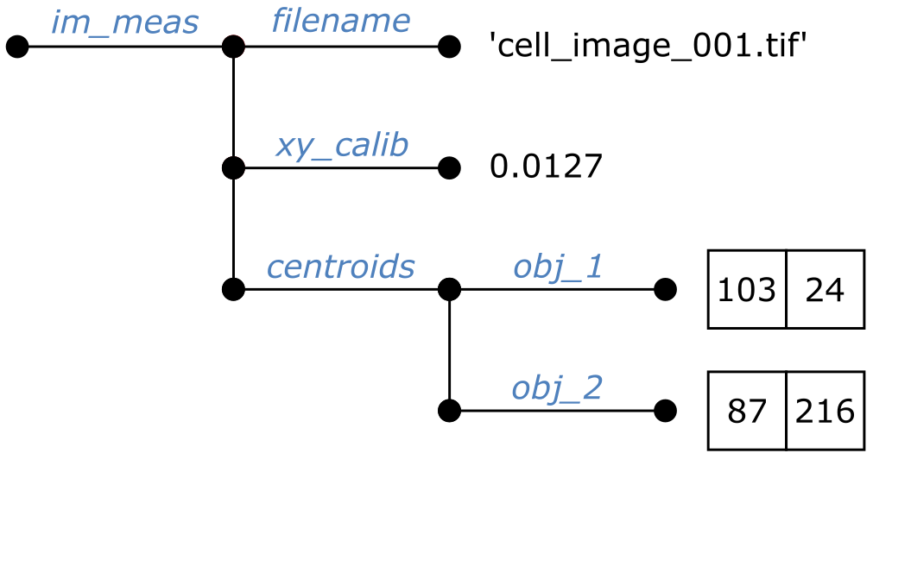
Structure arrays
Values stored as “fields”
Accessed using that field’s reference via dot notation
Can hold different data types in each field
Can have fields within fields
Example struct creation
im_meas.filename = ‘cell_image_001.tif’
im_meas.xy_calib = 0.0127
im_meas.centroids.obj_1 = [103, 24]
im_meas.centroids.obj_2 = [87, 216]
im_meas.centroids.obj_3 = [4, 68]

Slide 12
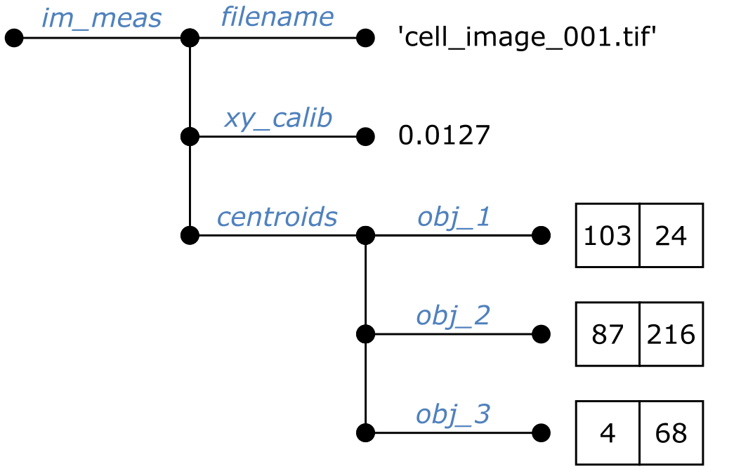
Structure arrays
Values stored as “fields”
Accessed using that field’s reference via dot notation
Can hold different data types in each field
Can have fields within fields
Example struct creation
im_meas.filename = ‘cell_image_001.tif’
im_meas.xy_calib = 0.0127
im_meas.centroids.obj_1 = [103, 24]
im_meas.centroids.obj_2 = [87, 216]
im_meas.centroids.obj_3 = [4, 68]

Slide 13
Structure arrays
Accessing data in a struct
Similar to assignment, using dot notation
Accessing our example struct
filename = im_meas.filename
xy_calib = im_meas.xy_calib
obj1_cent = im_meas.centroids.obj_1
obj2_cent_x = im_meas.centroids.obj_3(1)
obj3_cent_y = im_meas.centroids.obj_3(2)

Slide 14
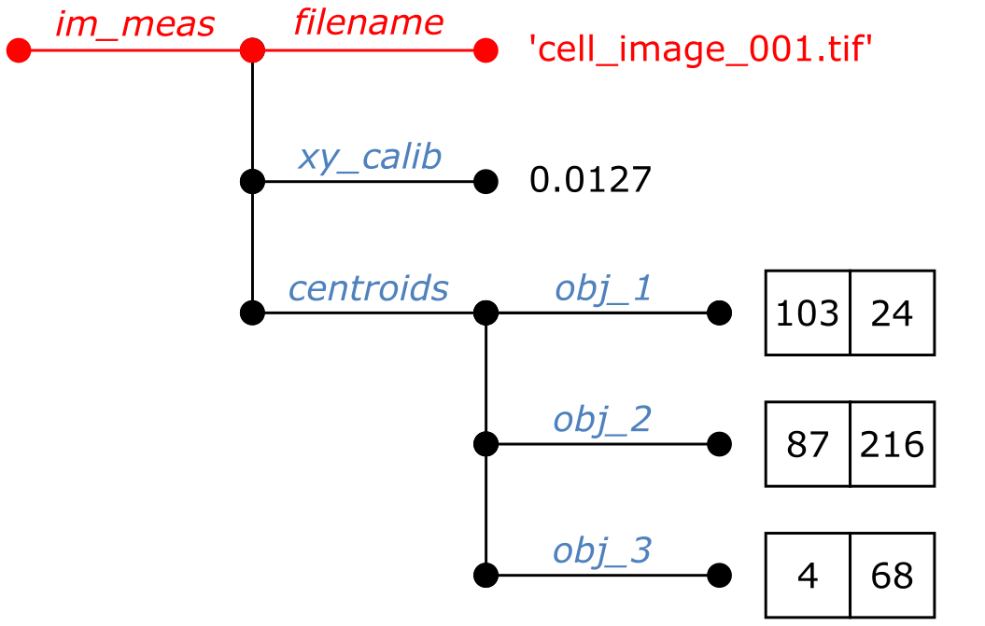
Structure arrays
Accessing data in a struct
Similar to assignment, using dot notation
Accessing our example struct
filename = im_meas.filename
xy_calib = im_meas.xy_calib
obj1_cent = im_meas.centroids.obj_1
obj2_cent_x = im_meas.centroids.obj_3(1)
obj3_cent_y = im_meas.centroids.obj_3(2)

Slide 15
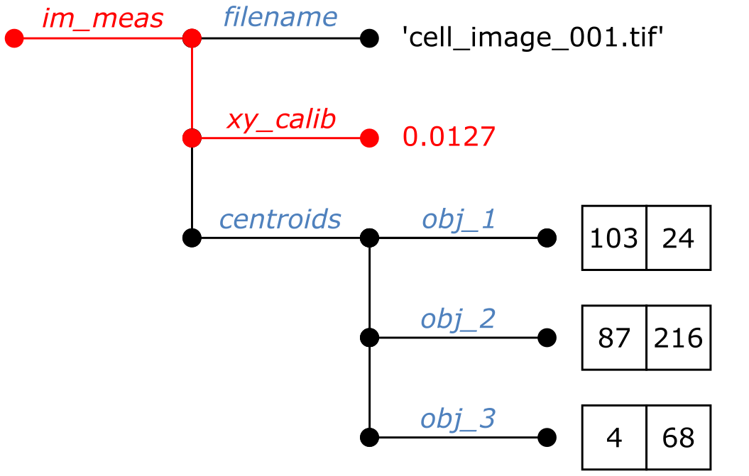
Structure arrays
Accessing data in a struct
Similar to assignment, using dot notation
Accessing our example struct
filename = im_meas.filename
xy_calib = im_meas.xy_calib
obj1_cent = im_meas.centroids.obj_1
obj2_cent_x = im_meas.centroids.obj_3(1)
obj3_cent_y = im_meas.centroids.obj_3(2)

Slide 16
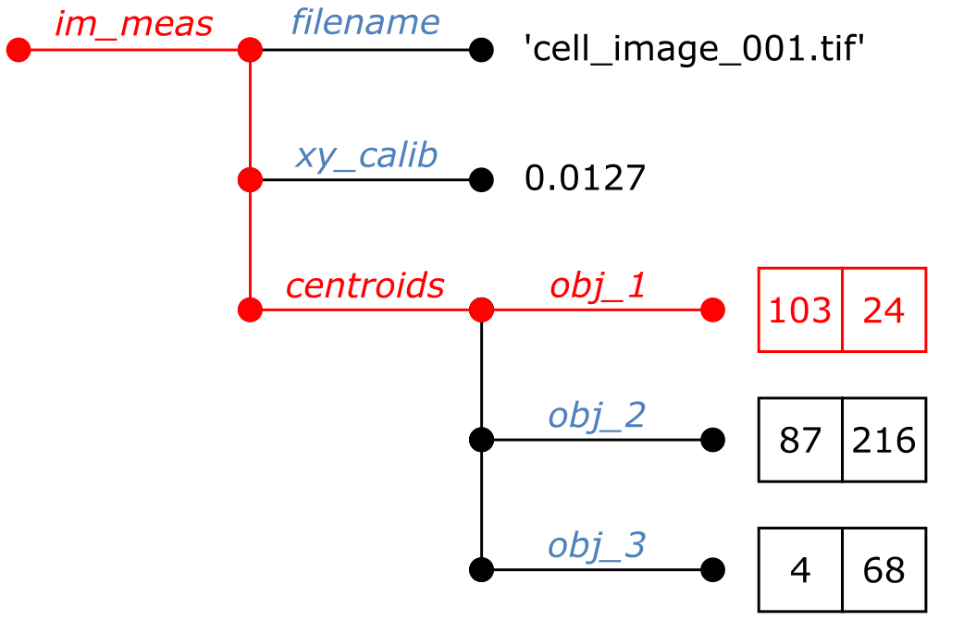
Structure arrays
Accessing data in a struct
Similar to assignment, using dot notation
Accessing our example struct
filename = im_meas.filename
xy_calib = im_meas.xy_calib
obj1_cent = im_meas.centroids.obj_1
obj2_cent_x = im_meas.centroids.obj_3(1)
obj3_cent_y = im_meas.centroids.obj_3(2)

Slide 17
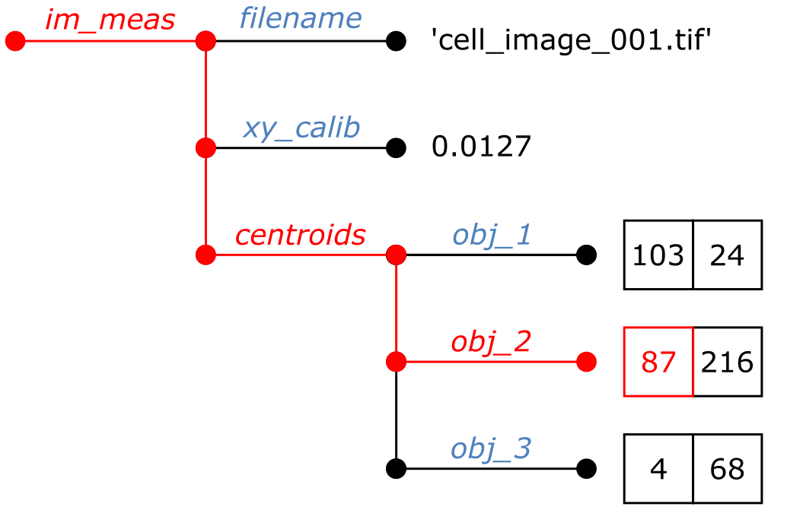
Structure arrays
Accessing data in a struct
Similar to assignment, using dot notation
Accessing our example struct
filename = im_meas.filename
xy_calib = im_meas.xy_calib
obj1_cent = im_meas.centroids.obj_1
obj2_cent_x = im_meas.centroids.obj_3(1)
obj3_cent_y = im_meas.centroids.obj_3(2)

Slide 18
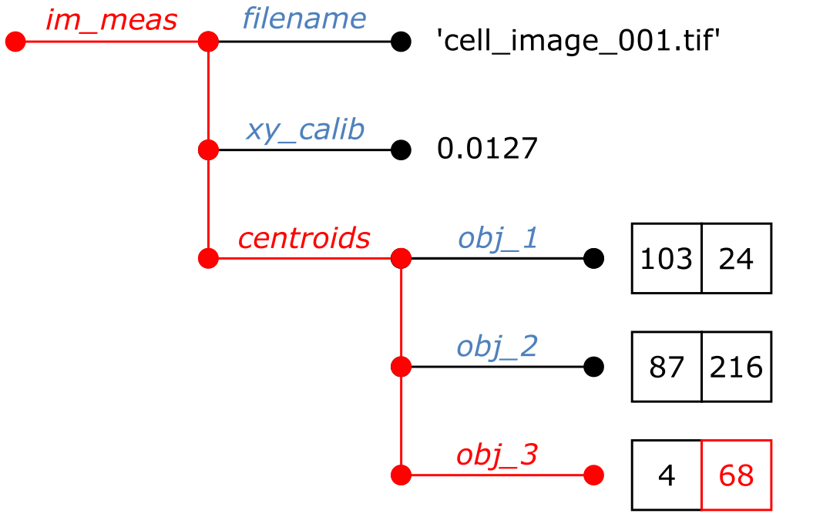
Structure arrays
Accessing data in a struct
Similar to assignment, using dot notation
Accessing our example struct
filename = im_meas.filename
xy_calib = im_meas.xy_calib
obj1_cent = im_meas.centroids.obj_1
obj2_cent_x = im_meas.centroids.obj_3(1)
obj3_cent_y = im_meas.centroids.obj_3(2)

Slide 19
Structure arrays
Exercise setup: Loading an example structure from file
Download ‘struct_example.mat’ from the GitHub (Session 3)
Load the example structure array from file using the following command
load(‘struct_example.mat’);
You will now have a structure array in the workspace called “ex_struct”
This structure array contains an image, a brief description of the image and
the time and date on which it was acquired.
https://github.com/SJCross/MATLAB-course

Slide 20
Structure arrays
Exercise: Accessing data in a structure array
Use imshow to display the image contained in ex_struct
In the command window, display the image description
Find the day, month and year on which the image was acquired

Slide 21
Structure arrays
Exercise: Accessing data in a structure array
Did you see this image?
The description was
'SRRF image of microtubules’
The date of acquisition was
22-10-2019

Slide 22
Cell arrays
Notes:
Convert this into 2 spider diagrams if there’s time

Slide 23
Cell arrays
Similar to arrays, but each element is a “cell”
Regular grid of cells
Can be N-dimensional
Can hold different data types in each cell
A cell can hold any data type, for example
Single numeric values
Text
Numeric arrays and matrices
Even another cell array!

Slide 24
Cell arrays
Similar to arrays, but each element is a “cell”
Regular grid of cells
Can be N-dimensional
Can hold different data types in each cell
A cell can hold any data type, for example
Single numeric values
Text
Numeric arrays and matrices
Even another cell array!

Slide 25
Cell arrays
Similar to arrays, but each element is a “cell”
Regular grid of cells
Can be N-dimensional
Can hold different data types in each cell
A cell can hold any data type, for example
Single numeric values
Text
Numeric arrays and matrices
Even another cell array!
0.9
-128

Slide 26
Cell arrays
Similar to arrays, but each element is a “cell”
Regular grid of cells
Can be N-dimensional
Can hold different data types in each cell
A cell can hold any data type, for example
Single numeric values
Text
Numeric arrays and matrices
Even another cell array!
‘some text’
0.9
-128
‘more stuff’

Slide 27
Cell arrays
Similar to arrays, but each element is a “cell”
Regular grid of cells
Can be N-dimensional
Can hold different data types in each cell
A cell can hold any data type, for example
Single numeric values
Text
Numeric arrays and matrices
Even another cell array!
‘some text’
0.9
1.2 | 3.7
0.7 | -5.5
-128
‘more stuff’

Slide 28
Cell arrays
Similar to arrays, but each element is a “cell”
Regular grid of cells
Can be N-dimensional
Can hold different data types in each cell
A cell can hold any data type, for example
Single numeric values
Text
Numeric arrays and matrices
Even another cell array!
‘some text’
0.9
1.2 | 3.7
0.7 | -5.5
-128
‘more stuff’
‘a’
42

Slide 29
Cell arrays
Create cell arrays using braces
Same method as creating arrays (rows, then columns)
To create our example cell array
Creating the 2x2 array
num_arr = [1.2, 3.7; 0.7, -5.5]
Creating the mini cell array
mini_cell = {‘a’,42}
Creating the main cell array
cell_array = { 0.9 , ‘some_text’ ; num_arr , -128 ; ‘more stuff’ , mini_cell }
‘some text’
0.9
1.2 | 3.7
0.7 | -5.5
-128
‘more stuff’
‘a’
42

Slide 30
Structure arrays
Exercise: Creating a cell array
Create a cell array containing the data to the right (the 2x2 grids can be randomly generated)
Access both values in the second column using a single command
0.6 | 0.7
0.1 | 0.3
‘obj1’
21
0.8 | 0.4
0.5 | 0.2
‘obj2’
-5.3

Slide 31
Tables
Notes:
Convert this into 2 spider diagrams if there’s time

Slide 32
Tables
The “state of the art” of MATLAB stores
Added in MATLAB 2013b
Can hold mixed data types
Access data by column name and row index
Easier to use than cell arrays
Have dedicated properties, including:
Descriptions of table contents
Descriptions of columns
Units for each column
filename | n_obj | mean_area
im_1.tif | 32 | 4244
im_2.tif | 54 | 6653
im_3.tif | 7 | 3464
im_4.tif | 52 | 4562

Slide 33
Tables
Construct using table function
Each column is a function argument
Column names come from variable name
Example
Create columns as arrays or cell arrays
filenames = {'im_1.tif'; 'im_2.tif'; 'im_3.tif'; 'im_4.tif'}
obj_counts = [32; 54; 7; 52]
areas = [4244; 6653; 3464; 4562]
Create table from arrays
my_table = table(filenames, obj_counts, areas)
filename | n_obj | mean_area
im_1.tif | 32 | 4244
im_2.tif | 54 | 6653
im_3.tif | 7 | 3464
im_4.tif | 52 | 4562

Slide 34
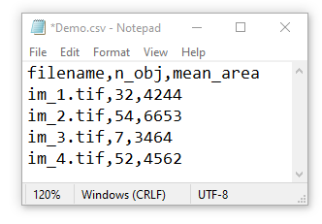
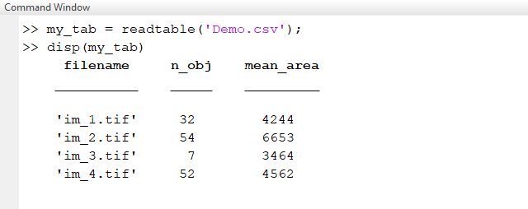
Tables
Load from file with readtable function
Works with CSVs and Excel files
Enable/disable header reading with ‘ReadVariableNames’
Example CSV reading

Slide 35
Tables
Load from file with readtable function
Works with CSVs and Excel files
Enable/disable header reading with ‘ReadVariableNames’
Example CSV reading

Slide 36
Tables
Load from file with readtable function
Works with CSVs and Excel files
Enable/disable header reading with ‘ReadVariableNames’
Example CSV reading
This column was identified as text
These columns were identified as numeric

Slide 37
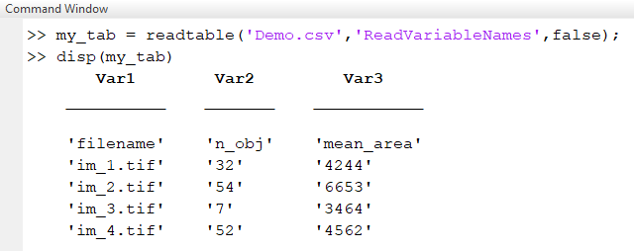
Tables
Load from file with readtable function
Works with CSVs and Excel files
Enable/disable header reading with ‘ReadVariableNames’
Example CSV reading

Slide 38
Tables
Load from file with readtable function
Works with CSVs and Excel files
Enable/disable header reading with ‘ReadVariableNames’
Example CSV reading
Now, all columns were identified as text

Slide 39
Tables
Accessing data in tables
Specify columns using dot notation
Like structure arrays
Specify using row, column indices
Like numeric arrays
Some examples
Using our table from file
Column by name
Row by index
Row and column indices

Slide 40
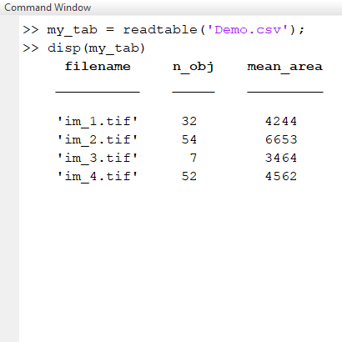
Tables
Accessing data in tables
Specify columns using dot notation
Like structure arrays
Specify using row, column indices
Like numeric arrays
Some examples
Using our table from file
Column by name
Row by index
Row and column indices

Slide 41
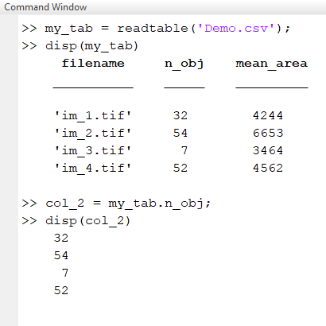
Tables
Accessing data in tables
Specify columns using dot notation
Like structure arrays
Specify using row, column indices
Like numeric arrays
Some examples
Using our table from file
Column by name
Row by index
Row and column indices

Slide 42
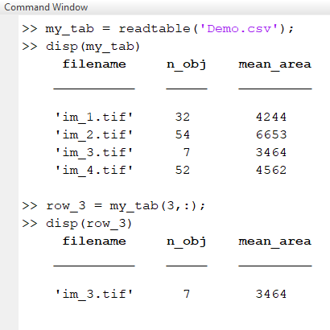
Tables
Accessing data in tables
Specify columns using dot notation
Like structure arrays
Specify using row, column indices
Like numeric arrays
Some examples
Using our table from file
Column by name
Row by index
Row and column indices

Slide 43
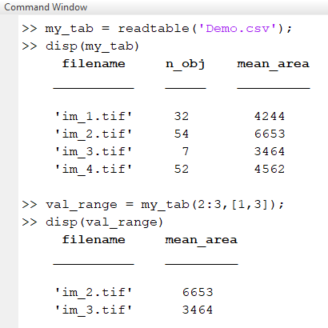
Tables
Accessing data in tables
Specify columns using dot notation
Like structure arrays
Specify using row, column indices
Like numeric arrays
Some examples
Using our table from file
Column by name
Row by index
Row and column indices

Slide 44
Structure arrays
Exercise: Loading tables and accessing data
Download the file ‘table_example.csv’ from GitHub (Session 3)
Use the readtable function to load the table to file
Display the table in the command window
Use the mean function to get the mean number of cells (the mean function takes a numeric array as an argument).
https://github.com/SJCross/MATLAB-course

Slide 45
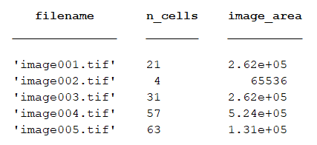
Structure arrays
Exercise: Loading tables and accessing data
To read the table
my_tab = readtable(‘table_example.csv’)
To get the mean number of cells
mean_n_cells = mean(my_table.n_cells)
The mean number of cells was 35.2
https://github.com/SJCross/MATLAB-course

Slide 46
Object-oriented programming
Notes:
Convert this into 2 spider diagrams if there’s time

Slide 47
What is object-oriented programming?
“Object-oriented programming (OOP) is a programming paradigm based on the concept of "objects", which can contain data, in the form of fields (often known as attributes or properties), and code, in the form of procedures (often known as methods).”
Wikipedia: “Object-oriented programming”

Slide 48

What is object-oriented programming?
What are classes?
Classes describe what properties and methods an object has
An object can only belong to one class
What are objects?
Data structures with a specific set of properties and methods (functions)
Objects are instances of a class
What are superclasses and subclasses?
Classes can be extended to subclasses
Subclasses have access to all properties and methods of the superclass

Slide 49
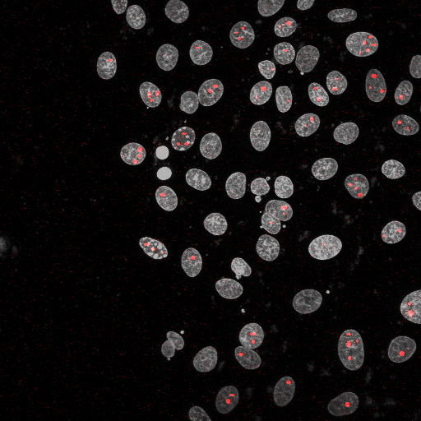
What is object-oriented programming?
Puncta (about 60 instances of these)
Nuclei (about 50 instances of these)
Image (1 instance of these)

Slide 50
What is object-oriented programming?
Class: Image
Properties
3D pixel array (XYC)
Spatial calibration
Methods
Display image

Slide 51
What is object-oriented programming?
Class: Image
Properties
3D pixel array (XYC)
Spatial calibration
Methods
Display image
Class: Volume
Properties
Pixel coordinates
Methods
Calculate centroid
Measure intensity
This definition applies to both nuclei and puncta

Slide 52
What is object-oriented programming?
What are classes?
Classes describe what properties and methods an object has
An object can only belong to one class
What are objects?
Data structures with a specific set of properties and methods (functions)
Objects are instances of a class
What are superclasses and subclasses?
Classes can be extended to subclasses
Subclasses have access to all properties and methods of the superclass

Slide 53
What is object-oriented programming?
Class: Image
Properties
3D pixel array (XYC)
Spatial calibration
Methods
Display image
Class: Volume
Properties
Pixel coordinates
Methods
Calculate centroid
Measure intensity

Slide 54
What is object-oriented programming?
Class: Image
Properties
3D pixel array (XYC)
Spatial calibration
Methods
Display image
Class: Puncta
Extends Volume
Properties
Parent nucleus
Methods
Get shortest dist. to nuclear surface
Class: Nuclei
Extends Volume
Properties
List of puncta
Methods
Get num. of puncta
Class: Volume
Properties
Pixel coordinates
Methods
Calculate centroid
Measure intensity

Slide 55
What is object-oriented programming?
Class: Nuclei
Extends Volume
Properties
List of puncta
Methods
Get num. of puncta
Class: Image
Properties
3D pixel array (XYC)
Spatial calibration
Methods
Display image
Class: Volume
Properties
Pixel coordinates
Methods
Calculate centroid
Measure intensity
Class: Puncta
Extends Volume
Properties
Parent nucleus
Methods
Get shortest dist. to nuclear surface

Slide 56
What is object-oriented programming?
Classes don’t have to correspond to physical “objects”
Class | Properties | Methods
Results table | Table/array holding numeric results | Save to file, calculate statistics

Slide 57
What is object-oriented programming?
Classes don’t have to correspond to physical “objects”
Class | Properties | Methods
Results table | Table/array holding numeric results | Save to file, calculate statistics
Image loader | File path | Load whole stack, load single image

Slide 58
What is object-oriented programming?
Classes don’t have to correspond to physical “objects”
Class | Properties | Methods
Results table | Table/array holding numeric results | Save to file, calculate statistics
Image loader | File path | Load whole stack, load single image
Spot detector | Intensity threshold, expected spot radius | Detect spots in image, automatically set threshold

Slide 59
What is object-oriented programming?
Classes don’t have to correspond to physical “objects”
Class | Properties | Methods
Results table | Table/array holding numeric results | Save to file, calculate statistics
Image loader | File path | Load whole stack, load single image
Spot detector | Intensity threshold, expected spot radius | Detect spots in image, automatically set threshold
Plot window | Position on screen, image being displayed | Move window, close window

Slide 60
Defining objects
Notes:
Convert this into 2 spider diagrams if there’s time

Slide 61
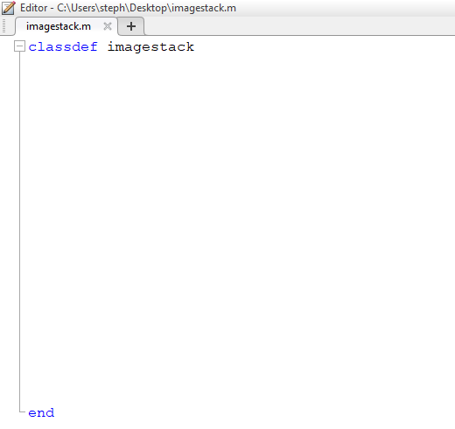
Defining objects
Define classes in class files
Must start with a classdef declaration
Properties listed under properties
List of properties the object can have
Methods listed under methods
Functions that objects of this class can use
“Constructor” has same name as the class
Refer to object instance with obj
Always first argument (except for constructor)

Slide 62
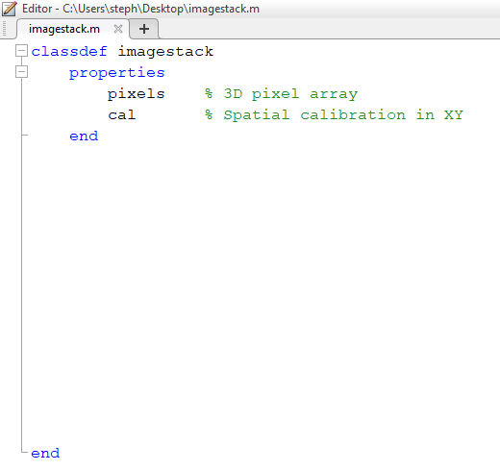
Defining objects
Define classes in class files
Must start with a classdef declaration
Properties listed under properties
List of properties the object can have
Methods listed under methods
Functions that objects of this class can use
“Constructor” has same name as the class
Refer to object instance with obj
Always first argument (except for constructor)

Slide 63
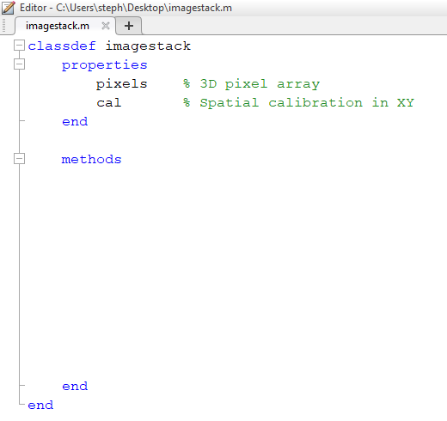
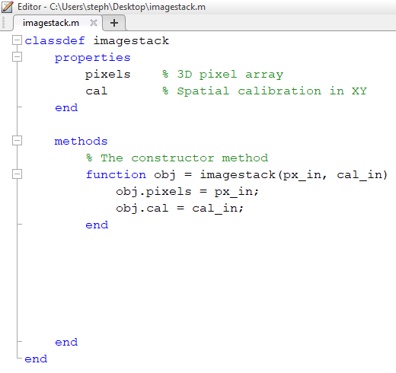
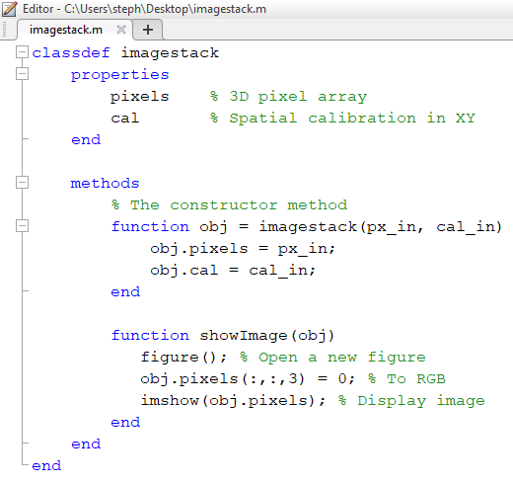
Defining objects
Define classes in class files
Must start with a classdef declaration
Properties listed under properties
List of properties the object can have
Methods listed under methods
Functions that objects of this class can use
“Constructor” has same name as the class
Refer to object instance with obj
Always first argument (except for constructor)

Slide 64
Using objects
Notes:
Convert this into 2 spider diagrams if there’s time

Slide 65
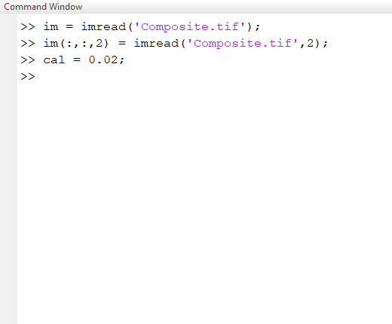
Using objects
Create a new instance of an object using the constructor method
This is a function call, where the new object is the output
Access properties using dot notation
Similar to structure arrays
Works for access and updating
Methods act on that object instance
Also use dot notation
Initialising properties

Slide 66
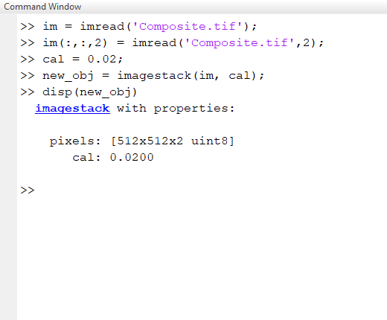
Using objects
Create a new instance of an object using the constructor method
This is a function call, where the new object is the output
Access properties using dot notation
Similar to structure arrays
Works for access and updating
Methods act on that object instance
Also use dot notation
Creating a new object instance

Slide 67
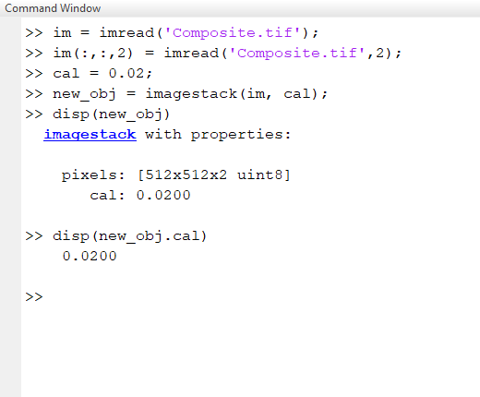
Using objects
Create a new instance of an object using the constructor method
This is a function call, where the new object is the output
Access properties using dot notation
Similar to structure arrays
Works for access and updating
Methods act on that object instance
Also use dot notation
Accessing object properties

Slide 68
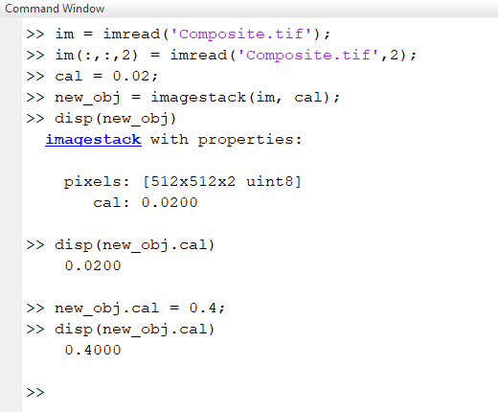
Using objects
Create a new instance of an object using the constructor method
This is a function call, where the new object is the output
Access properties using dot notation
Similar to structure arrays
Works for access and updating
Methods act on that object instance
Also use dot notation
Updating object properties

Slide 69
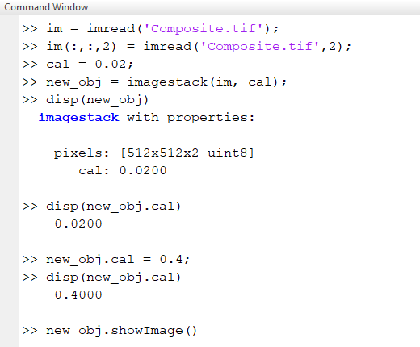
Using objects
Create a new instance of an object using the constructor method
This is a function call, where the new object is the output
Access properties using dot notation
Similar to structure arrays
Works for access and updating
Methods act on that object instance
Also use dot notation
Using a method

Slide 70
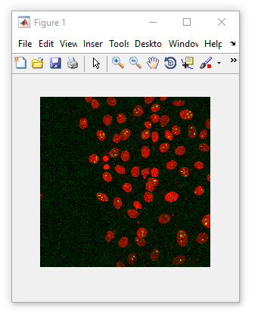
Using objects
Create a new instance of an object using the constructor method
This is a function call, where the new object is the output
Access properties using dot notation
Similar to structure arrays
Works for access and assignment
Methods act on that object instance
Also use dot notation
Using a method

Slide 71
Using objects
Exercise background: Using objects
We can get a blank window using the figure function
(this will be covered in Session 4)
fig = figure()
We get a list of its properties by typing fig. then pressing tab
One of these properties is Position, which returns a 4-element numeric array
[left, bottom, width, height]

Slide 72
Using objects
Exercise: Using objects
Use the figure function to create a new figure object and assign it a reference
Display the Position of the figure and in the command window
Keep the figure the same size, but move it so left = 300 and bottom = 100

Slide 73
Advanced image reading (Bio-Formats)
This is a chance to see cell arrays and OOP in action
Notes:
Convert this into 2 spider diagrams if there’s time

Slide 74
Bio-Formats and MATLAB
What is Bio-Formats Reader?
Java-based library for reading proprietary image formats
Developed by The Open Microscopy Environment (OME)
What formats does it support?
Over 150 formats supported
Of note for users of Wolfson Bioimaging Facility
Leica .lif (most widefields and confocals)
Zeiss .czi (lightsheet)
PerkinElmer .flex (high content system)

Slide 75
Bio-Formats and MATLAB
Bio-Formats can also read image metadata
Metadata is information about the image, included in the file
Metadata can include
Time and date
Spatial calibration (distance per pixel)
Illumination parameters (e.g. laser powers)
Metadata is stored in a standardised OME format
Promotes consistency in metadata access between formats

Slide 76
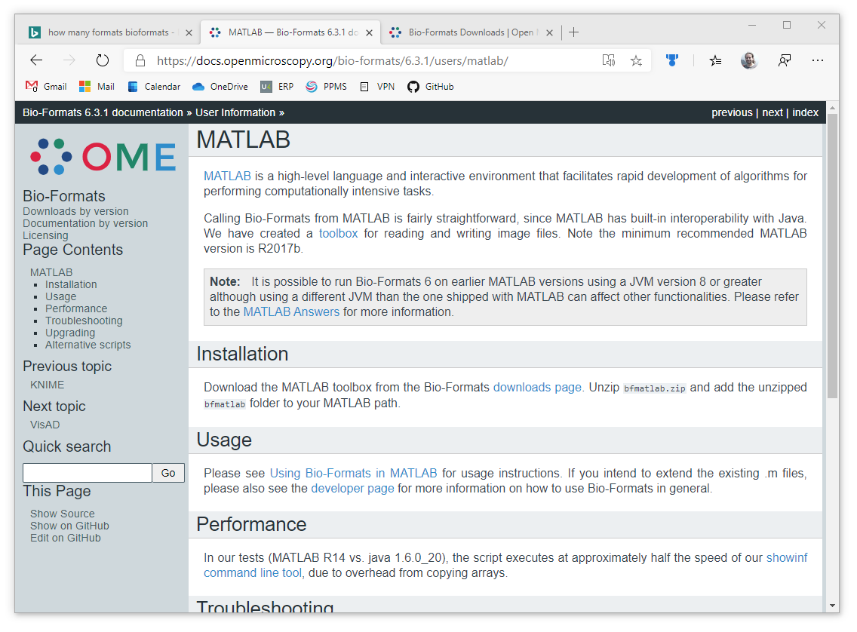
Bio-Formats and MATLAB
https://docs.openmicroscopy.org/bio-formats/6.3.1/users/matlab/

Slide 77
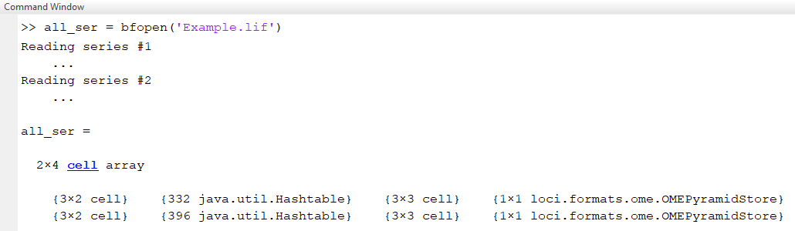
Bio-Formats and MATLAB
Basic image loading with bfopen
Outputs nested cell structure with one row per series
Core image data

Slide 78
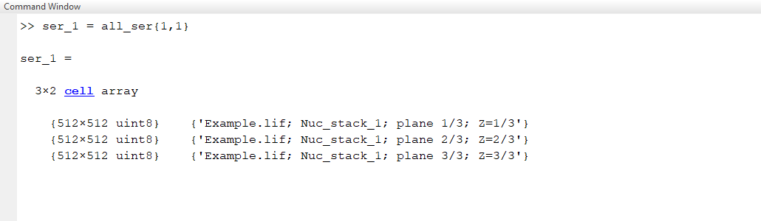
Bio-Formats and MATLAB
Basic image loading with bfopen
Outputs nested cell structure with one row per series
Image pixel data
(one row per image)

Slide 79
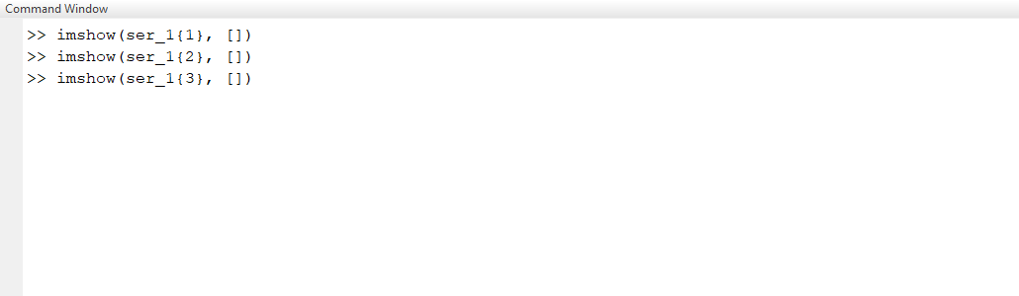
Bio-Formats and MATLAB
Basic image loading with bfopen
Outputs nested cell structure with one row per series

Slide 80
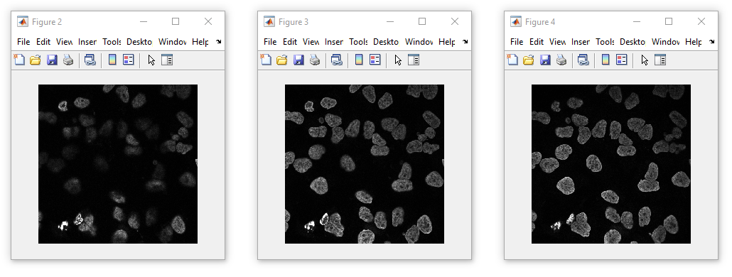
Bio-Formats and MATLAB
Basic image loading with bfopen
Outputs nested cell structure with one row per series

Slide 81
Bio-Formats and MATLAB
Basic image loading with bfopen
Outputs nested cell structure with one row per series
Image description

Slide 82
Bio-Formats and MATLAB
Basic image loading with bfopen
Outputs nested cell structure with one row per series
Raw metadata
(Java HashTable object)

Slide 83
Bio-Formats and MATLAB
Basic image loading with bfopen
Outputs nested cell structure with one row per series
Colourmap data

Slide 84
Bio-Formats and MATLAB
Basic image loading with bfopen
Outputs nested cell structure with one row per series
OME metadata structure
(this is an object)

Slide 85
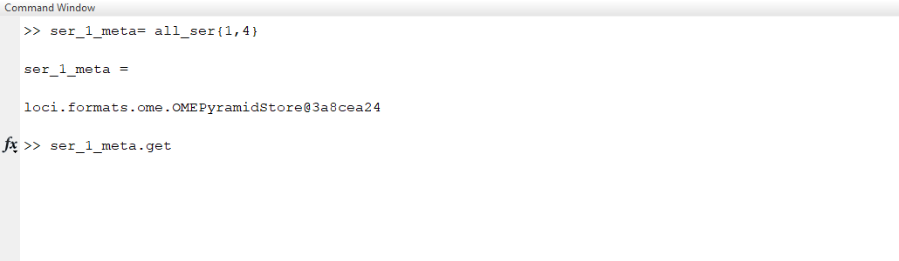
Bio-Formats and MATLAB
Basic image loading with bfopen
Outputs nested cell structure with one row per series
Type .get, then press tab

Slide 86
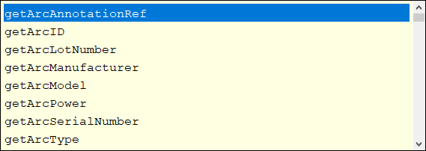
Bio-Formats and MATLAB
Basic image loading with bfopen
Outputs nested cell structure with one row per series

Slide 87
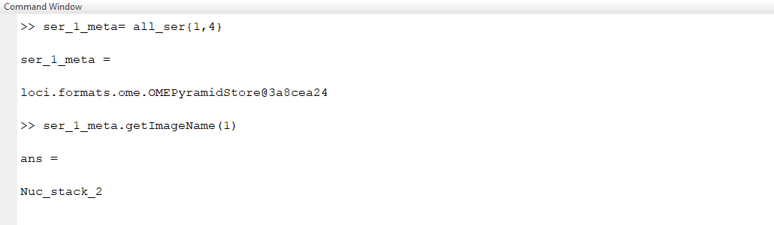
Bio-Formats and MATLAB
Basic image loading with bfopen
Outputs nested cell structure with one row per series

Slide 88
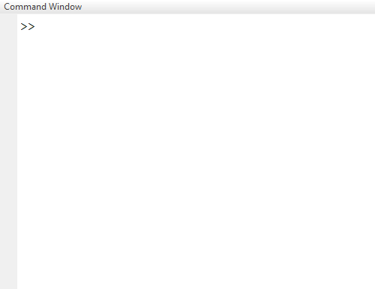
Bio-Formats and MATLAB
All data is loaded to the PC using bfopen
What if we only want a single series?
Access individual planes with the Bio-Formats reader object
Get the Bio-Formats Reader object
Set the file series number (zero indexed)
Reading a single plane
Here, we’re loading the 3rd image
Accessing the reader’s OME metadata store
Use the reader’s getMetadataStore method

Slide 89
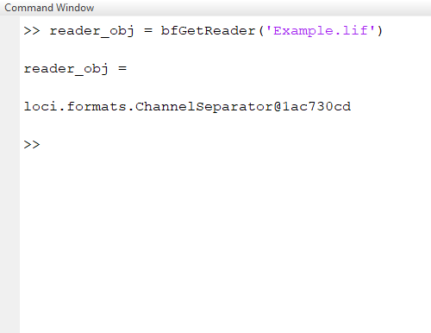
Bio-Formats and MATLAB
All data is loaded to the PC using bfopen
What if we only want a single series?
Access individual planes with the Bio-Formats reader object
Get the Bio-Formats Reader object
Set the file series number (zero indexed)
Reading a single plane
Here, we’re loading the 3rd image
Accessing the reader’s OME metadata store
Use the reader’s getMetadataStore method

Slide 90
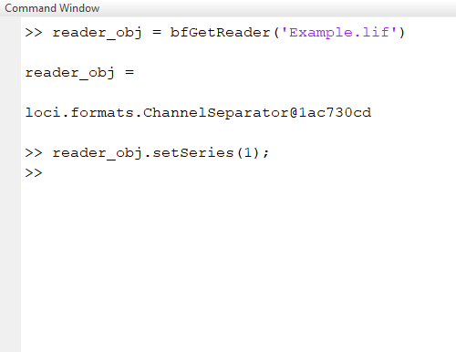
Bio-Formats and MATLAB
All data is loaded to the PC using bfopen
What if we only want a single series?
Access individual planes with the Bio-Formats reader object
Get the Bio-Formats Reader object
Set the file series number (zero indexed)
Reading a single plane
Here, we’re loading the 3rd image
Accessing the reader’s OME metadata store
Use the reader’s getMetadataStore method

Slide 91
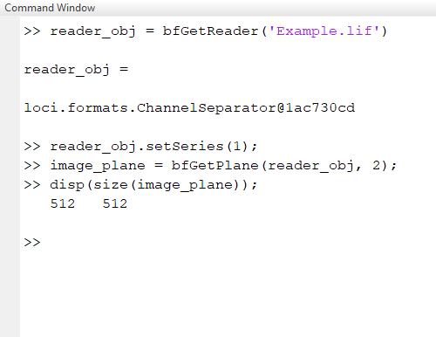
Bio-Formats and MATLAB
All data is loaded to the PC using bfopen
What if we only want a single series?
Access individual planes with the Bio-Formats reader object
Get the Bio-Formats Reader object
Set the file series number (zero indexed)
Reading a single plane
Here, we’re loading the 3rd image
Accessing the reader’s OME metadata store
Use the reader’s getMetadataStore method

Slide 92
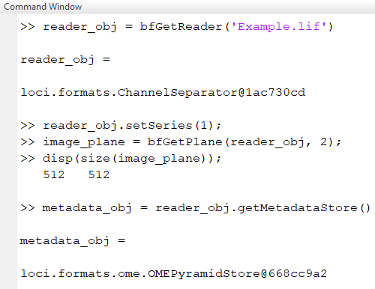
Bio-Formats and MATLAB
All data is loaded to the PC using bfopen
What if we only want a single series?
Access individual planes with the Bio-Formats reader object
Get the Bio-Formats Reader object
Set the file series number (zero indexed)
Reading a single plane
Here, we’re loading the 3rd image
Accessing the reader’s OME metadata store
Use the reader’s getMetadataStore method

Slide 93
Bio-Formats and MATLAB
Working with higher dimensionality image stacks
Images indices are linearised
Convert ZCT position to index
Use getIndex(z_index, c_index, t_index)
Example
Initialise the reader
Check image stack size
Get the linearised index (Z=10, C=2, T=1)
Load the image as before

Slide 94
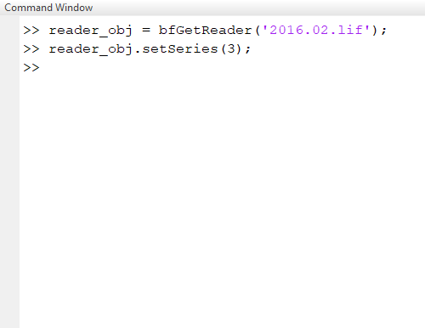
Bio-Formats and MATLAB
Working with higher dimensionality image stacks
Images indices are linearised
Convert ZCT position to index
Use getIndex(z_index, c_index, t_index)
Example
Initialise the reader
Check image stack size
Get the linearised index (Z=10, C=2, T=1)
Load the image as before

Slide 95
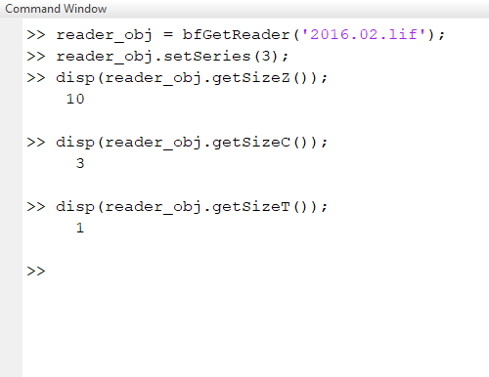
Bio-Formats and MATLAB
Working with higher dimensionality image stacks
Images indices are linearised
Convert ZCT position to index
Use getIndex(z_index, c_index, t_index)
Example
Initialise the reader
Check image stack size
Get the linearised index (Z=10, C=2, T=1)
Load the image as before

Slide 96
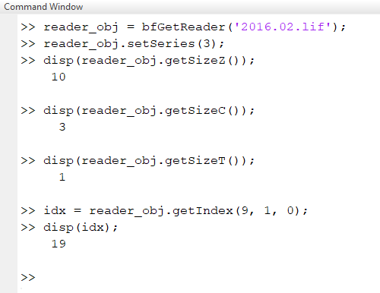
Bio-Formats and MATLAB
Working with higher dimensionality image stacks
Images indices are linearised
Convert ZCT position to index
Use getIndex(z_index, c_index, t_index)
Example
Initialise the reader
Check image stack size
Get the linearised index (Z=10, C=2, T=1)
Load the image as before

Slide 97
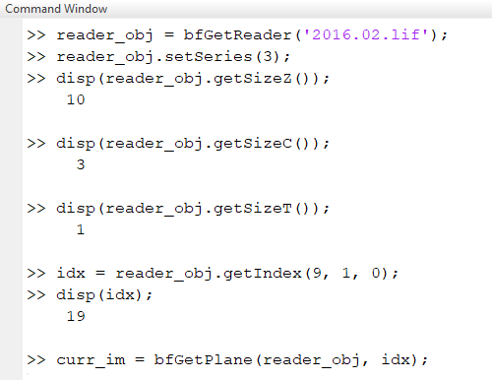
Bio-Formats and MATLAB
Working with higher dimensionality image stacks
Images indices are linearised
Convert ZCT position to index
Use getIndex(z_index, c_index, t_index)
Example
Initialise the reader
Check image stack size
Get the linearised index (Z=10, C=2, T=1)
Load the image as before

Slide 98
Questions?!
Notes:
Convert this into 2 spider diagrams if there’s time

Slide 99
Under construction!
Comments/requests?
Let me know!
stephen.cross@bristol.ac.uk

